Slide 1
Apache Traffic Control

Slide 2
Content Delivery Network
CDN is a distributed system of servers for delivering content over HTTP(s).
These servers are deployed in multiple locations with the goal of optimizing the delivery of content to the end users, while minimizing traffic on the network.

Slide 3
Traffic Control
Traffic Control was first developed at Comcast for internal use and released to Open Source in April of 2015. Traffic Control moved into the Apache Incubator in August of 2016.

Slide 4
CDN Architecture
Cache servers : Cache Server is a server that both proxies the request and caches the results for reuse. Traffic Control uses ATS to provide cache server.
Content Router: Content Router ensures that the end user is connected to optimal cache server for the location of the end user and content availability.
Health Protocol: Health protocol monitors the usage of cache servers and tenants in the CDN.
Configuration Management System:Traffic OPS is the database and Traffic Portal is the interface.
Log Analysis: Traffic Stats

Slide 5
Cache Group
Group of Cache Servers.
Typically a cache Group is representative of the available cache servers within a specific geographical location.
When Cache Server are chosen to serve content to a client based on geographical location the geographical location actually used for comparison is that of cache group.
Most Typical Cache Groups are EDGE_LOC which contains edge tier cache servers and MID_LOC which contains mid-tier cache servers.
Cache Group is a logical grouping of cache server. There is no strict requirement that cache servers in a Cache Group share a Physical Location, Region, or Division.

Slide 6
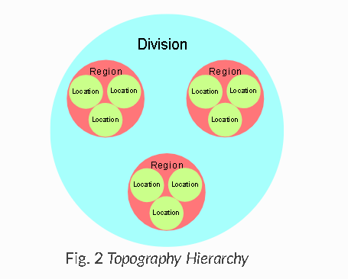
Regions, Divisions and Locations
Every server has a physical location which defines their geographical longitude and latitude.
Each physical location is part of a region and each region is part of a division.
For eg Kathmandu could be name of physical location in the Bagmati Province Region that could be part of Nepal division.

Slide 7
Delivery Services
At their most basic, they are a source of content and a set of cache servers and configuration options used to distribute that content.
Please see https://traffic-control-cdn.readthedocs.io/en/latest/overview/delivery_services.html

Slide 8
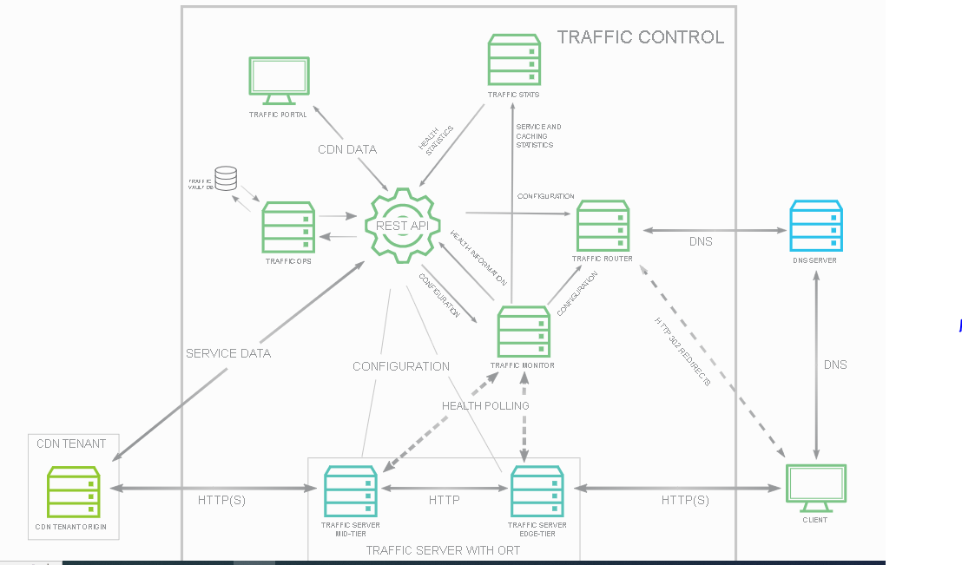
Traffic Control

Slide 9
Profiles and Parameters
Profiles are a collection of configuration options, defined partially by the Profile’s Type (not to be confused with the more general “Type” used by many other things in Traffic Control) and partially by the Parameters set on them.
Mainly, Profiles and Parameters are used to configure cache servers, but they can also be used to configure parts of (nearly) any Traffic Control component, and can even be linked with more abstract concepts like Delivery Services and Cache Groups.

Slide 10
Traffic Monitor
Traffic Monitor is an HTTP service that monitors the cache servers in a CDN for a variety of metrics.
These metrics are for use in determining the overall “health” of a given cache server and the related Delivery Services
Traffic Monitor provides a view into CDN health using several RESTful JSON endpoints, which are consumed by other Traffic Monitors and downstream components such as Traffic Router.
Traffic Monitor polls all cache servers configured with a status of REPORTED or ADMIN_DOWN at an interval specified as a configuration parameter in Traffic Ops

Slide 11
Traffic Monitor(cont…)
If a cache server is marked ADMIN_DOWN it is marked as unavailable but still polled for availability and statistics.
If cache server is explicitly configured with the status of ONLINE or OFFLINE, it is not polled and presents to Traffic Router are configured, regardless of its availability.
Traffic Monitor makes HTTP requests at regular intervals to a special URL on each Edge-tier cache server and consumes the JSON output.
The special URL is served by a plugin called astats.
Many of the application-level statistics are available at the global or aggregate level, some at the Delivery Service level
Traffic Monitor uses the system-level performance to determine the overall health of the cache server by evaluating network throughput and load against values configured in Traffic Ops. Traffic Monitor also uses throughput and transaction statistics at the Delivery Service level to determine Delivery Service health.
Traffic Monitors in cluster use optimistic health protocol.

Slide 12
Traffic Router
Traffic Router’s function is to send clients to the most optimal cache server. ‘Optimal’ in this case is based on a number of factors:
Distance between the cache server and the client (not necessarily measured in physical distance, but quite often in layer 3 network hops).
Availability of cache servers and the system processing/network load on the cache servers
Availability of content on a particular cache server. Reusing of content through “cache hits” is the most important performance gain a CDN can offer.

Slide 13
DNS Routing
When searching for https://cdn.electron.cdn.datahub.com.np . When Local DNS is resolving cdn.electron.cdn.datahub.com.np hostname to an ip address it ends up at traffic router because its authoritative name server is Traffic Router.
Traffic Router then responds with the appropriate IP address based on the health and location of cache server.
The client then connects to the cache server with port 80 or port 443.
The cache server includes the remap rule to route the request.

Slide 14
HTTP Routing
For an HTTP Delivery Service the client might receive a URL such as https://video.demo1.mycdn.ciab.test/.
The LDNS resolves video.demo1.mycdn.ciab.test to an ip address but in this case it returns its own ip address.
The client then opens connection to port 80 or 443 on the Traffic Router’s IP address and sends it request.
Then Traffic Router uses a HTTP 302 Found response to redirect the client to the best cache server.
In this case the Traffic Router has access to more information when selecting the cache server like client’s ip address, url the client is requesting ,all http1.1 headers

Slide 15
Traffic Router Administration
Ensure that parent domain (for eg. Datahub.com.np) contains a delegation (NameServer Record) for the traffic router and the value specified matches the FQDN of the Traffic Router.
Because previously taken CDN Snapshots will be cached, they need to be removed manually to actually be reloaded.
Configuration files are /opt/traffic_router/conf
Much of traffic router configuration can be obtained from the parameters on its profile in Traffic Portal(under CRConfig.json)

Slide 16
Traffic OPS
Traffic Ops is the tool for administration (configuration and monitoring) of all components in a Traffic Control CDN.
Traffic Portal uses the Traffic Ops API to manage servers, Cache Groups, Delivery Services, etc.
Traffic Ops uses a PostgreSQL database to store the configuration information, and a combination of the Mojolicious framework and Go to provide the Traffic Ops API.
Traffic Ops generates all the application-specific configuration files for the cache servers and other servers.

Slide 17
Traffic Vault
Not all configuration data is in this database however; for sensitive data like private SSL keys or token-based authentication shared secrets, Traffic Vault is used as a separate, key/value store, allowing administrators to harden the Traffic Vault server better from a security perspective (i.e only allow Traffic Ops to access it, verifying authenticity with a certificate).

Slide 18
Traffic Portal

Slide 19
Traffic Stats
Shows the statistics of the CDN
3 Parts to it influxdb, grafana and traffic_stats.

Slide 20
InfluxDb
InfluxDB is a time series database designed to handle high write and query loads.
Custom high performance datastore written specifically for time series data. The TSM engine allows for high ingest speed and data compression
Written entirely in Go. It compiles into a single binary with no external dependencies.
Simple, high performing write and query HTTP APIs.
Expressive SQL-like query language tailored to easily query aggregated data.
The open source edition of InfluxDB runs on a single node.

Slide 21
Commands
Influx –ssl –port 80 –host trafficmonitor-infra.datahub.com
To show Database ( show databases)
To use Database ( use database_name)
To show all the parameters (show measurements)
Select statement ( select * from measurement_name)

Slide 22
Continous Queries
Continuous queries (CQ) are InfluxQL queries that run automatically and periodically on realtime data and store query results in a specified measurement.
CREATE CONTINOUS QUERY <cq_name> ON <database_name> BEGIN <cq_query> END
<cq_query> requires a function, an INTO clause and a Group By time()

Slide 23
RETENTION POLICIES

